Slide 1
Device to detect pesticides in fruits and vegetables
Domain : HealthTech
Team Name : Elite Coders
Team Members :
Sathyanarayanan S
Arsadha C
Deepak R
Poorani M
Department of ECE
Karpagam Institute of Technology, Coimbatore.

Slide 2
Problem Statement:
Device to check healthiness of vegetables and fruits.
Description of Problem:
The use of pesticides, steroids and fertilizers in vegetables and fruits has tremendously increased.
It is known that chemicals which are banned in other countries and also by the Indian Government are heavily used without the knowledge of the authorities and the consumers.
Innocent consumers are unknowing getting their health deteriorated due to their inability to notice the presence of harmful chemicals in the food items.
Solution:
The main idea of this project is to detect the amount of pesticides on vegetables and fruits by calculating the NDVI (Normalized Difference Vegetation Index) by using IR sensors.

Slide 3
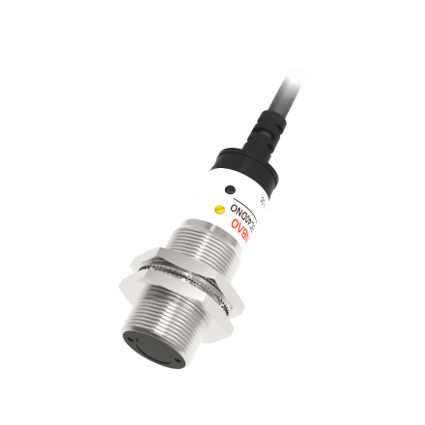
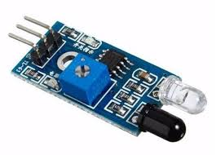
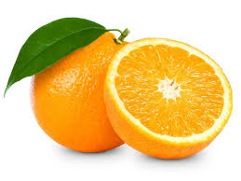
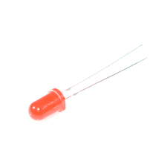
Technique Used:
Healthy vegetation absorbs most of the visible light and less IR light that hits it, and reflects a large portion of the near-infrared light. Unhealthy or sparse vegetation reflects more visible light and less near-infrared light.
Incident IR
Reflected IR
Incident Visible
Reflected Visible

Slide 4
Dependencies:
LED, photo electric sensor, Arduino
Photoelectric
sensor
LCD
Arduino
IR Sensor
Power supply
LED

Slide 5

Use Case:
In Grocery stores to make people believe that their products are healthy.
Price Estimation:
Power supply Circuit - Rs.100
LCD Display - Rs.150
Photoelectric Sensor - Rs.100
Light Emitting Diode - Rs.25
Amplifier LL358 Gain - Rs.100
Arduino Uno Kit - Rs.550
TOTAL COST - Rs.1025

Slide 6

Conclusion:
Thus we developed the low cost, pocket friendly and easy to use system to detect level of pesticides in fruits and vegetables. Hope this would be helpful for people to indentify the sparse vegetables and live their healthy life.

